Slide 1
ULTIMA SOLUTIONS
?
The Prime Mover of Digital Solutions
94 Summit St. Davenport, IA 52807 | +9082 09284 | ultima@solutions.com

Slide 2
Agenda
AN INNOVATION
This summer crazy sale will be held at the Downtown Palace on April 01, 2025 from 8am onwards. Tickets start at $20 per person and will include free tech consultation with our professional staff in addition to a 75% discount on great selections. Profits gained from this event will be donated to Little Kids Learning Center for new school equipment and computers.
TECH START
This event will be held at the Downtown Activity Center room on September 30, 2025 from 10am to 7pm. Tickets will be at $50 per person and will entitle all attendees to a 50% discount for a purchase of at least $1500 worth of electronics. 50% of profits will be given to the Amazon Reforestation Event while the other 50% will be donated to Hope Future Learning Center for new school equipment.
MONTHLY BOARD MEETING
Members of the Board will be having their monthly meeting at the Manhattan, New York Ultima Solutions headquarters every month starting January 03, 2020 from 12pm to 6pm to discuss the company’s current status and future projects. Additionally, the monthly meeting will also discuss the status of the company’s budget, profit, future developed events and marketing impact of the Ultima Solutions.

Slide 3
About
Ultima Solutions is a digital marketing company located in Manhattan, New York and was founded in 2005 by Jerry Howards who was a former stockbroker, IT expert and philanthropist from
Illinois, Chicago.

Slide 4
Testimonial
“
I am always happy and satisfied with my purchases at Ultima Solutions. They do their best to help me find gadgets that are best suited to my needs and cost efficient.
- Scott Riley, 29, Social Media Artist

Slide 5
AN INNOVATION
April 01, 2025
Downtown Palace
Tickets will be at $50 per person and will entitle all attendees to a 50% discount for a purchase of at least $1500 worth of electronics. 50% of profits will be given to the Amazon Reforestation Event while the other 50% will be donated to Hope Future Learning Center for new school equipment.

Slide 6
TECH START
September 30, 2025
Downtown Activity Center
Ticket price starts at only $50 per person and will entitle all attendees to a 70% discount for a purchase of at least $3000 worth of electronics. With lots of amazing gadgets, website design and effective website strategies. 50% of the gained profit will be given to the Amazon Reforestation Event. The other 50% profit will be donated to Hope Future Learning Center for new school equipments.

Slide 7
MONTHLY BOARD MEETING
January 03, 2020
Ultima Solutions HQ, Manhattan, New York
This meeting will discuss the company’s current status and future projects, the company’s budget, profit, future developed events and marketing impact of the Ultima Solutions in the industry.

Slide 8
History
Ultima Solutions was founded in the year 2005 by Jerry Howardson who was a former stockbroker, university professor, IT expert and is now currently a philanthropist. He built the company with the aim of providing people in the digital marketing industry efficient and effective website products at competitive and reasonable price points. Today, Ultima Solutions has a total of 5,000 active employees with currently 3 branches (and counting) in Los Angeles, New York and Chicago.

Slide 9
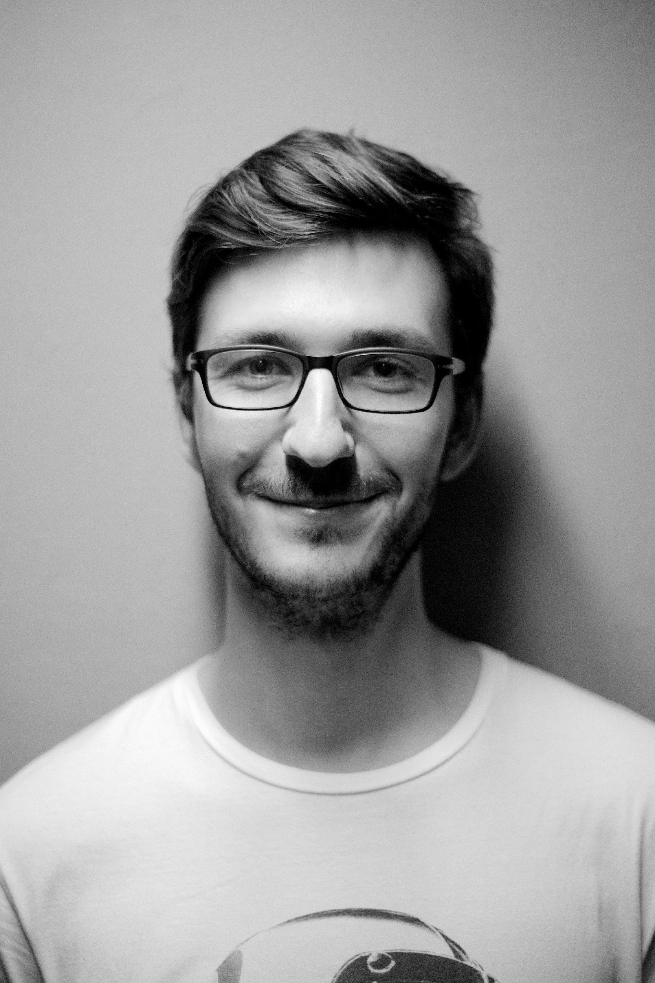
Testimonial From Guest
“
Ultima Solutions is a company that is passionate in terms of providing quality service and gadgets. I’m glad and thankful I got to avail of their services.
-Jerome Brookes, 25, Website Developer

Slide 10
Main Goal
Ultima Solutions’ main goal is to become a well renowned and trusted website product provider in addition to becoming a leading digital marketing agency in the country.

Slide 11
Overview of Growth
30%
Increase in monthly profits as of May 2021
60%
Increase in event reviews as of June 2022
65%
Increase in sold products as of January 2022

Slide 12
What
We Offer
Effective Website Templates
Affordable Website Designs
Effective Web Marketing Strategies
Friendly & Reliable Service

Slide 13
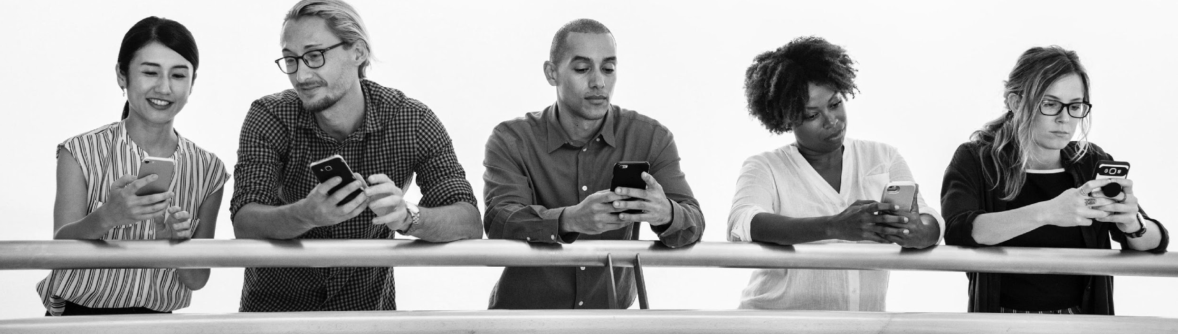
Image Gallery

Slide 14
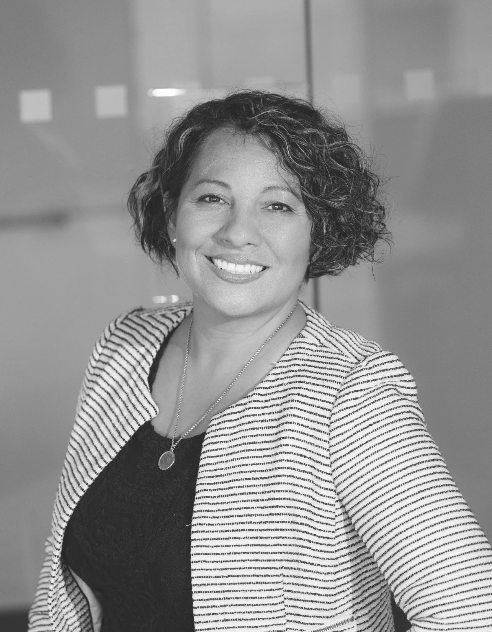
The Team
JOHN
JAMESON
Chief Operating Officer
JERRY
HOWARDSON
LAURA
KEATS
Founder & CEO
Chief Marketing Manager

Slide 15
THANK YOU
ultima@solutions.com

