Slide 1

Sponsorship
Pitch Deck

Slide 2

About Us
Living Financial Management Inc. is an insurance company based in Kansas, Missouri. Active since 1989, it was founded by Jonathan Masters who was a former economist and currently an entrepreneur.

Slide 3

Vision
Our vision is to provide effective and affordable financial support and insurance to all our clients based on the company values of discipline, honesty, and integrity.

Slide 4

Mission
Our mission is to become a leading insurance company by the year 2030, and gain a loyal client base of no less than 50,000 individuals by the year 2035.

Slide 5


The Team
Ivy Green
Larry James
Team Leader
Insurance Agent
Manages the team’s overall performance and help them improve.
Assists and guides customers in building a financial plan with the company.

Slide 6


The Team
Bruce Wallace
Jordan Quest
Insurance Agent
Customer Service Representative
Assists and guides customers in building a financial plan with the company.
Interacts with the customers by giving information about the company.
Provides solutions to any problems the customer may be experiencing.

Slide 7

The Problem
The Entrepreneur Magazine’s survey conducted in January 2017 showed that roughly 54% of the 4,000 businesses in Kansas dealt with financial problems due to (1) money mismanagement and (2) lack of proper company insurance policies.

Slide 8

Our Solution
Living Financial Management Inc. will offer:
A wide range of insurance policies applicable to individuals, couples, families, and businesses.
Free consultations for the first 10 clients every calendar month.
Monthly insurance deposit fees starting at just $10.

Slide 9

Advantages
Due to roughly 70% of individuals and 54% of businesses in need of financial guidance, Living Financial Management Inc. will be able to have an extensive client base due to (1) the lack of an effective and reliable insurance company in the state, (2) the number of individuals in need of financial aid, and (3) the number of businesses in need of a stable company insurance policy for its employees.

Slide 10

Stabilize Project
“STABILIZE” is an insurance policy that can be personalized according to an individual’s or company’s wants and needs. Together with our professional, well trained insurance agents, STABILIZE project will offer the public with more than 10 insurance options starting at just $19.99 per month.

Slide 11
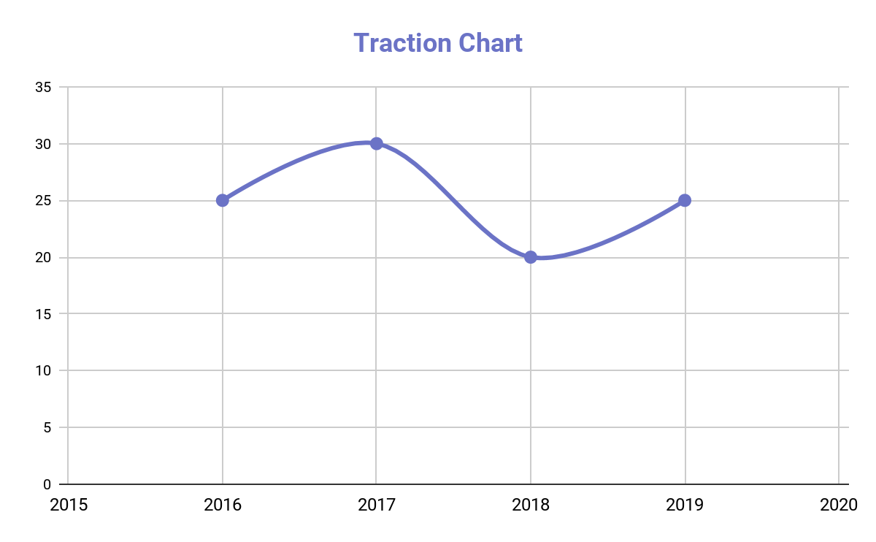
Traction
Based the bureau’s survey conducted in 2016, Kansas has a total population of 2.5 million people. Around 1.75 million individuals that make up this group seeks an insurance company that is affordable and highly reliable.

Slide 12
Target Market
The chosen target market will be the residents of Kansas. This specific group of individuals was chosen based on the following factors :
62%
of Kansas’ population are workers
Up to 239, 118 firms are looking for legal and affordable financial insurance
Roughly 204, 562 of the total firm population are newly established companies seeking for financial assistance

Slide 13
Competition
Based on a survey conducted in 2017, Living Financial Management Inc. concluded that the following companies will be considered as direct competitors :
J’s Financial Firm offers business and life financial assistance for customers at
$99.99
Jackson Insurance Inc. offers business and life financial assistance for customers at
$59.99
Financial Aid Inc. offers business and life financial assistance for customers at
$30.00

Slide 14
Alternative Solutions
The alternative solutions Living Financial Management Inc. can provide are the following:
Free consultation for the first 10 clients each calendar month.
Up to 25% interest rate for the first 100 customers.
1 month extensive marketing campaign and outreach program.
Free consultation for the first 10 clients each calendar month.
Up to
25%
interest rate for the first 100 customers.

Slide 15
Revenue equivalent to roughly $280,000 to $300,000 will be expected by the end of 2019
Business Model
The company will utilize the following business model which will be implemented by early 2019:
[SPECIFY BUSINESS MODEL]
Revenue equivalent to roughly $280,000 to $300,000 will be expected by the end of 2019.

Slide 16

Schedule
The company’s schedule will be as follows :
[SPECIFY COMPANY SCHEDULE]

Slide 17
Investing
In order to officially begin, the company will require a budget estimated between $230,000.00 and $250,000.00. This amount will be provided by the following sponsors :
1. Kansas National Bank
2. New York Chase & Co.
3. Financial Aid Inc.
Each sponsor has agreed to contribute and invest at least $100,000.00 for Living Financial Management Inc.

Slide 18

Contact Us
Visit our office every Monday to Friday from 9am to 6pm and Saturday from 9am to 4pm at [ADDRESS].
For more information contact any of these contact details :
[Phone Number]
[Email]
[Website]

Slide 19

Thank You

