Slide 1

Real Estate
Pitch Deck

Slide 2

About Us
Sta. Fe Land & Real Estate is a real estate company based in Long Island, New York. Active since 2003, it was founded by Jordan Bell who was a graduate in Economics from Yale University.

Slide 3

Vision
Our vision is to become the top real estate company across the state in the year 2025 by achieving the prestigious International Property Award and the World’s Finest Property Company Award.

Slide 4

Mission
Our mission is to provide great selections of quality real estate properties at competitive prices.

Slide 5


Real Estate Team
Kevin Kennedy
Tom Washington
Financial Services Advisor
Marketing Manager
In charge of giving financial advice to clients regarding money management, tax settlements and insurance decisions in availing a property.
In charge of implementing marketing strategies that promotes the company to draw potential customers.

Slide 6
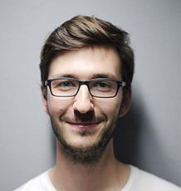

Real Estate Team
Kenneth Johnson
Ben David
Real Estate Broker
Real Estate Broker
In charge of arranging and settling deals and transactions between property buyers and sellers.
In charge of arranging and settling deals and transactions between property buyers and sellers.

Slide 7

The Problem
According to the general consensus from the Bureau of Land Management conducted in 2015, 7 out of 10 real estate agencies fail to comply with the needs and satisfaction of property buyers and sellers due to bad services and poor financial property assistance. This leads to bankruptcy and ultimately closure of up to 6 real estate firm every month in New York alone.

Slide 8

Our Solution
Sta. Fe Land & Real Estate offers quality financial and property management services for all people who wish to sell or own a land. Our well-trained and registered professional real estate brokers, financial advisers and other staff members are dedicated to provide the guidance, advice and assistance regarding real estate.

Slide 9

Advantages
Sta. Fe Land & Real Estate will provide quality real estate assistance. By providing effective strategies and authentic financial advice, our customers will get to enjoy their property searching experience.

Slide 10

All In Project
Our new project called “ALL IN” is aimed to provide affordable, effective, and sophisticated property service for all. With over 100 property guides and strategies aiming to sell or buy a property, the ALL IN project is dedicated to satisfy customers who are in need of financial and property assistance starting at just $100.
Property Assistance Starting At Just
$100

Slide 11
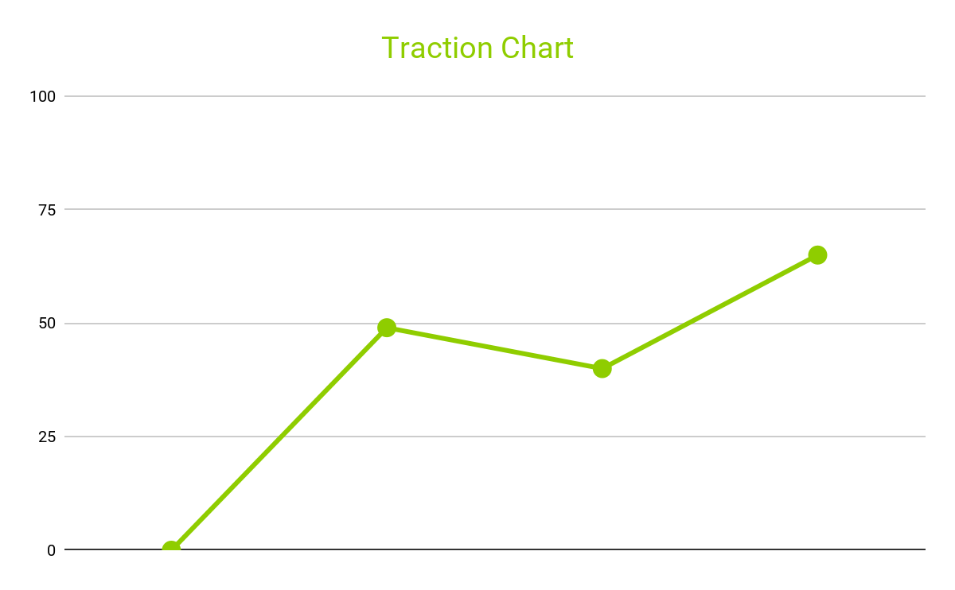
Traction
Based on a census conducted by the bureau, Long Island, New York has a total of 7, 869, 820 population as of 2017. About 49% or about 3, 856, 211 of the estimated population seeks property advice and financial guidance in selling or buying real estate.
49%
2017

Slide 12
Target Market
The chosen target market will be the residents of Long Island. This specific group of individuals was chosen based on the following factors :
Long Island’s population wishes to sell their property of
Population wishes to buy affordable real estate property of
Population are new settlers and are in need of property guidance and assistance of
60%
45%
40%

Slide 13
Competition
Based on a survey conducted in 2016, Sta. Fe Land & Real Estate concluded that the following companies will be considered as direct competitors:
$150
Big Empire Property Services offers financial and property assistance for customers
$200
Full Sale Land Inc., offers financial and property assistance for customers
$199.99
Long Island Real Estate Service offers financial and property assistance for customers

Slide 14
Alternative Solutions
The alternative solutions Sta. Fe Land & Real Estate can provide are the following:
Free one-on-one financial and property selling guide for the first 50 persons.
25%
Discount Service Promo For All Property Sellers
30%
Discount Service Promo For All Property Buyers

Slide 15

Business Model
The company will utilize the following business model which will be implemented by early 2019:
[SPECIFY BUSINESS MODEL]
Revenue equivalent to roughly $100,000 to $120,000 will be expected by the end of 2019.
$100,000 to $120,000 Revenue equivalent will be expected by the end of 2019

Slide 16

Schedule
The company’s schedule will be as follows :
[SPECIFY COMPANY SCHEDULE]

Slide 17
Investment
In order to officially begin, the company will require a budget estimated between $80,000.00 and $90,000.00. This amount will be collected from the following sponsors :
1. ATrade Corp.
2. Proven Financial Investment Corp.
3. Genesis Land Investment Inc.
$30,000.00
Each sponsor has agreed to contribute and invest for Sta. Fe Land & Real Estate

Slide 18

Contact Us
Visit our office every Monday to Friday from 9am to 6pm and Saturday from 9am to 4pm at [ADDRESS].
For more information contact any of these contact details :
[Phone Number]
[Email]
[Website]

Slide 19
Thank You

