Slide 1

Children Care
Foundation
Non-Profit PitchDeck
This one day sale will be held at the Downtown Showroom on February 14, 2021 from 10am to 6pm. Tickets start at $39.99 each and will entitle attendees to an 80% discount on purchases worth $2000 and above.

Slide 2

CHILDREN CARE FOUNDATION

Slide 3

vv
Summary
The Foundation
Offers and Services
Execution
Operational Plan
Start-up Summary
Testimonials

Slide 4
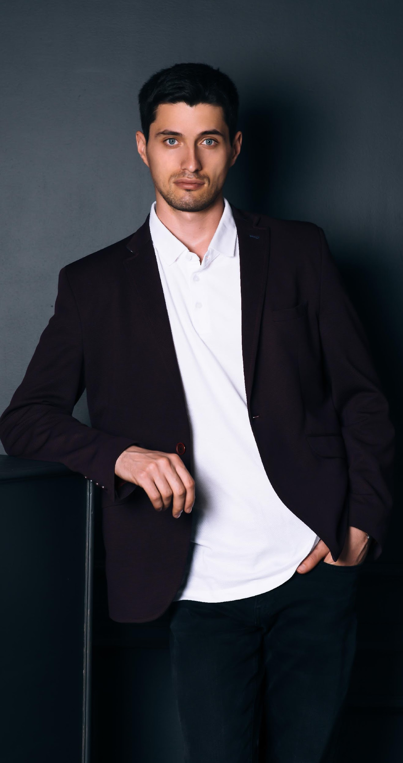
Gavin
Hudson
The Foundation
I am Gavin Hudson and I welcome you to Children Care Foundation.
This company is the fruit of all my struggles, pain and happiness in life. I am more than happy to introduce you the soon to be number 1 digital marketing agency in the country - Prime Solutions Agency.
The previous years gave us a glimpse of what this agency can claim and achieve. Now, this year holds a lot more challenges and expectations awaiting us. I am grateful to announce the new improvement plans.
Founder & CEO

Slide 5
Executive Summary
The Foundation
Children Care Foundation is a non-profit, non-government organization based in Michigan, Detroit. It has been philanthropically helping kids all over the country since 2001 & was founded by businessman-philanthropist Adam Harrison.
Children Care Foundation aims to give the care & treatment for orphaned children through education, physical activities, proper nutrition & loving care from foster mothers.

Slide 6
Mission - Vision - Philosophy
The Foundation
Our mission is to provide free care & services for orphaned
Provide every neglected children the right to good life, proper nutrition, education.
Promote equality, brotherhood & love to one another.
children.
We incorporate equality, unity & friendship value in providing genuine care to neglected children.
-Gavin Hudson, 59, Founder & CEO

Slide 7

History
First established in 2005 by Gavin Hudson, Children Care Foundation is a proud provider of superior digital products and services. With over 13 years of experience in the digital marketing industry, Prime Solutions Agency currently has 3 fully operating branches in New Mexico, Illinois and Seattle.

Slide 8

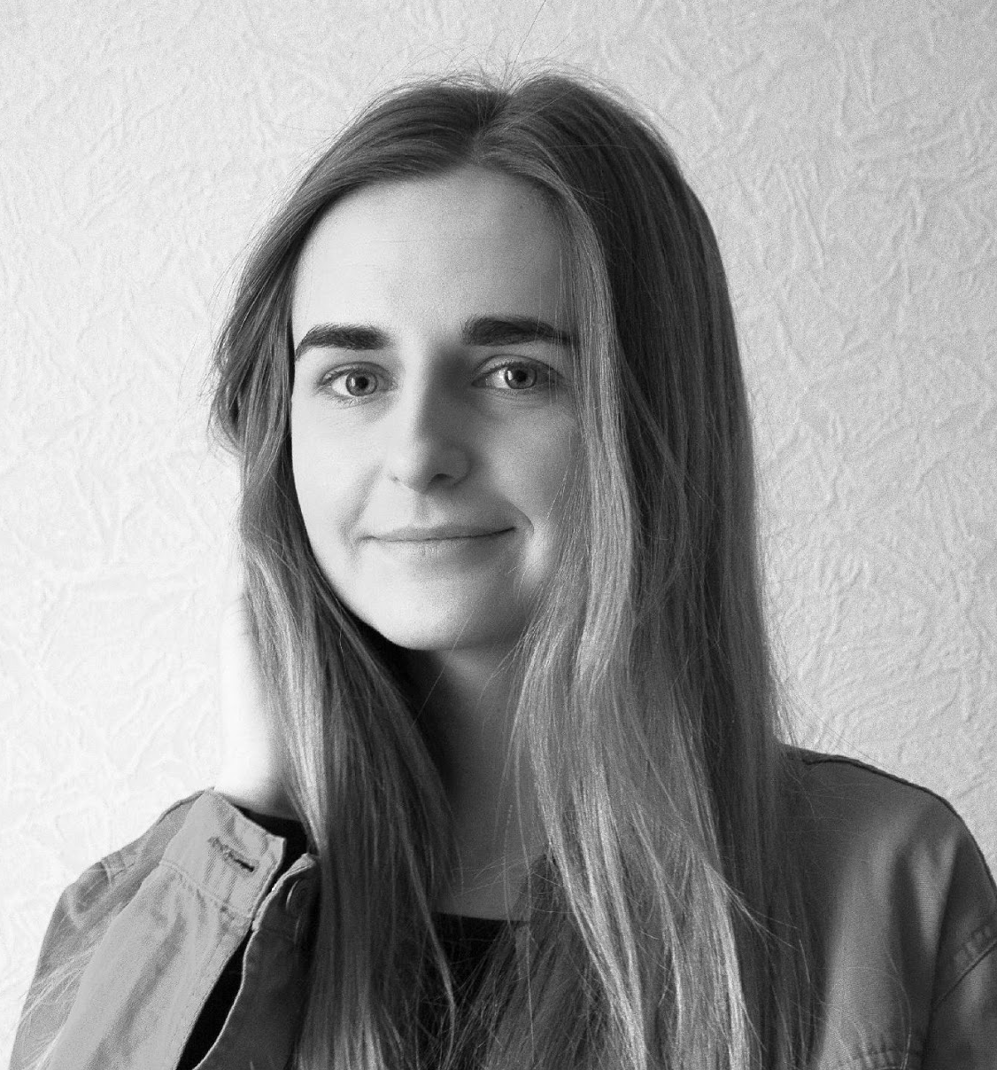
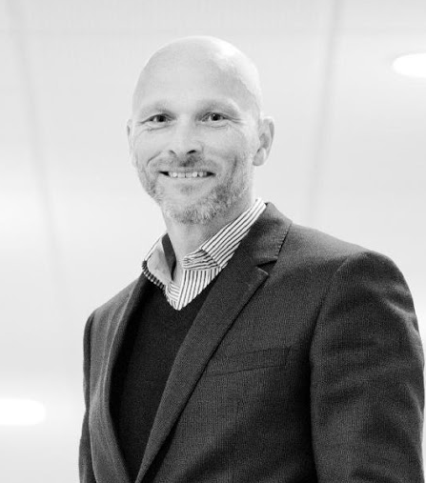
The Foundation
Management
The previous years gave us a glimpse of what this agency can claim and achieve. Now, this year holds a lot more challenges and expectations awaiting us. I am grateful to announce the new improvement plans and carefully planned events for all of our clients.
Iory Williams
Hailey Bush
Chad Mufeills
President
Volunteer
Chairman

Slide 9
CHILD CARE SERVICE

Slide 10

Humanitarian
Projects
Michigan State Feeding Program (April 2022)
Annual Children Sports Festival
Children Healthcare Examination (July 2025)
Annual Tree Planting

Slide 11
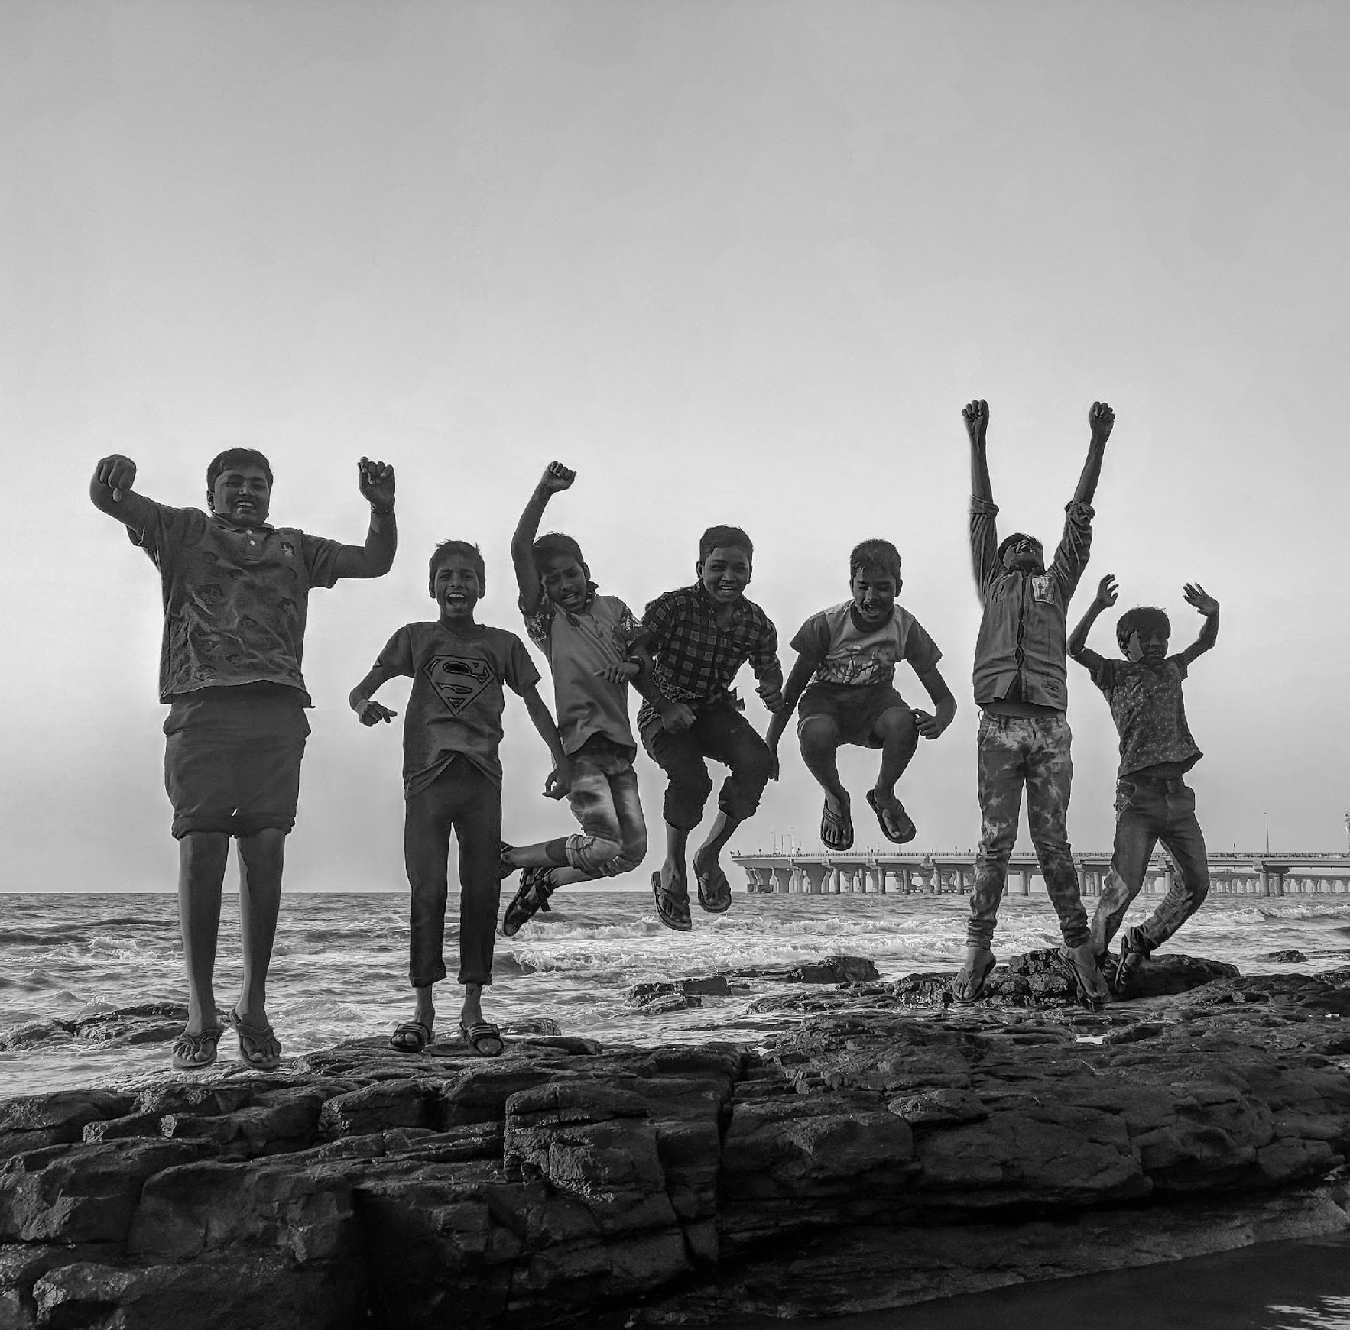
Benefactors
Service
• Harrison Malls, Inc.
• St. Luke’s Medical Institute
• Woodson Travel, Inc.
• St. Benedict Institute of Learning.
• CC Clothes, Ltd.
• Dawson Music School

Slide 12
EXECUTION

Slide 13
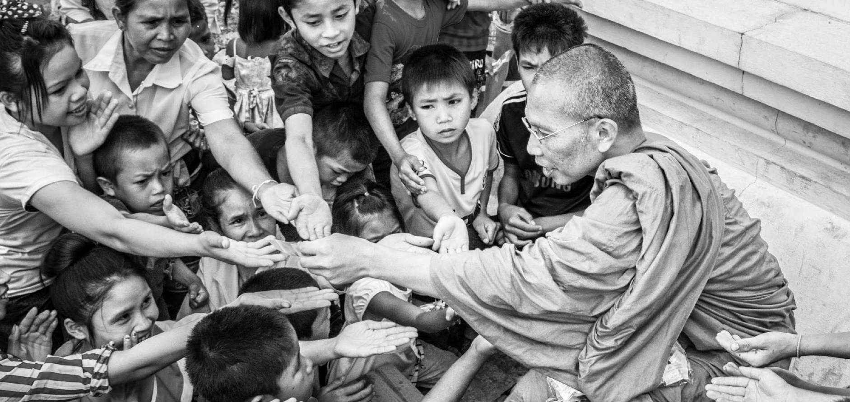
Execution
Market Research
As the information dissemination evolves, adapting to new ways of promoting events became a substantial challenge for companies.
With the emergence of social media & internet, online advertisement has become prevalent.

Slide 14

Marketing
Strategy
Execution
Marketing
Plan
• Focuses on target audience through social media & printed flyers.
• Effectively engaging with potential donors & beneficiaries.
Our marketing strategy emphasizes the combination of traditional & millennial styles of promoting.
• Televised Commercials
• Social Media Advertisements
• Printed Billboards & Flyers

Slide 15
OPERATIONAL PLAN

Slide 16
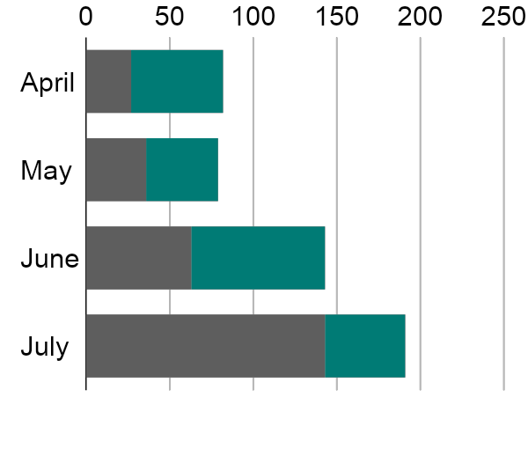
Operational Plan
Overview of Growth
60% increase in annual profits as of May 2021.
70% increase in satisfaction with developed website templates as of March 2021.
45% increase in clientele base as of March 2021.

Slide 17
Operational Plan
Marketing Infrastructure
Infrastructure
Existing (Y/N)
Description
Social Media
Y
The company has Twitter & Instagram accounts.
Website
N
Website is still in development.
Network Speed
N
Network is working properly & causes no delay in
company operations.
Data Storage
N
Company data storage as of now is still limited.

Slide 18
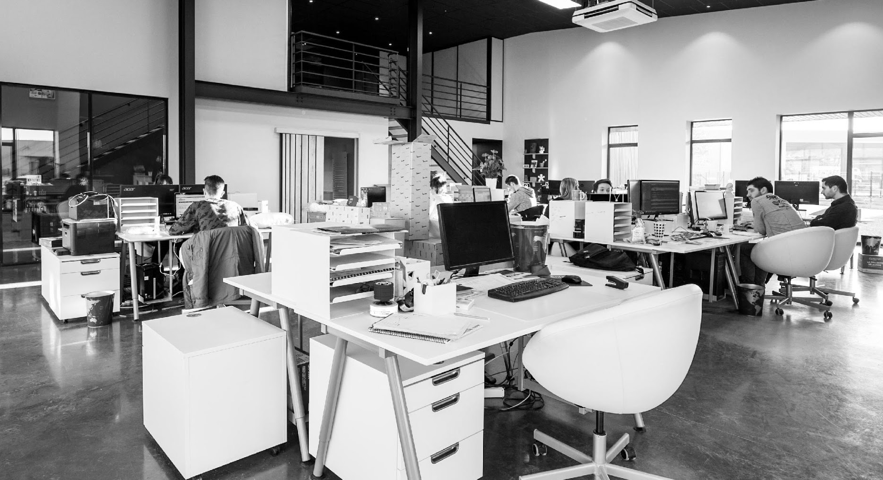
Operational Plan
Location
Facilities
Provide a sketch/ blueprint of the office.
• Provide photos/images of the office.

Slide 19
START-UP SUMMARY

Slide 20

Operational Plan
Startup
Requirements
Start-Up Expenses
Rent - 5 Months $20,000
Advertising $15,000
Legal Fees $5,000
Staff Training $5,000
Insurance $5,000
Other $0
Total Start-Up Expenses
$50, 0000

Slide 21
TESTIMONIALS

Slide 22
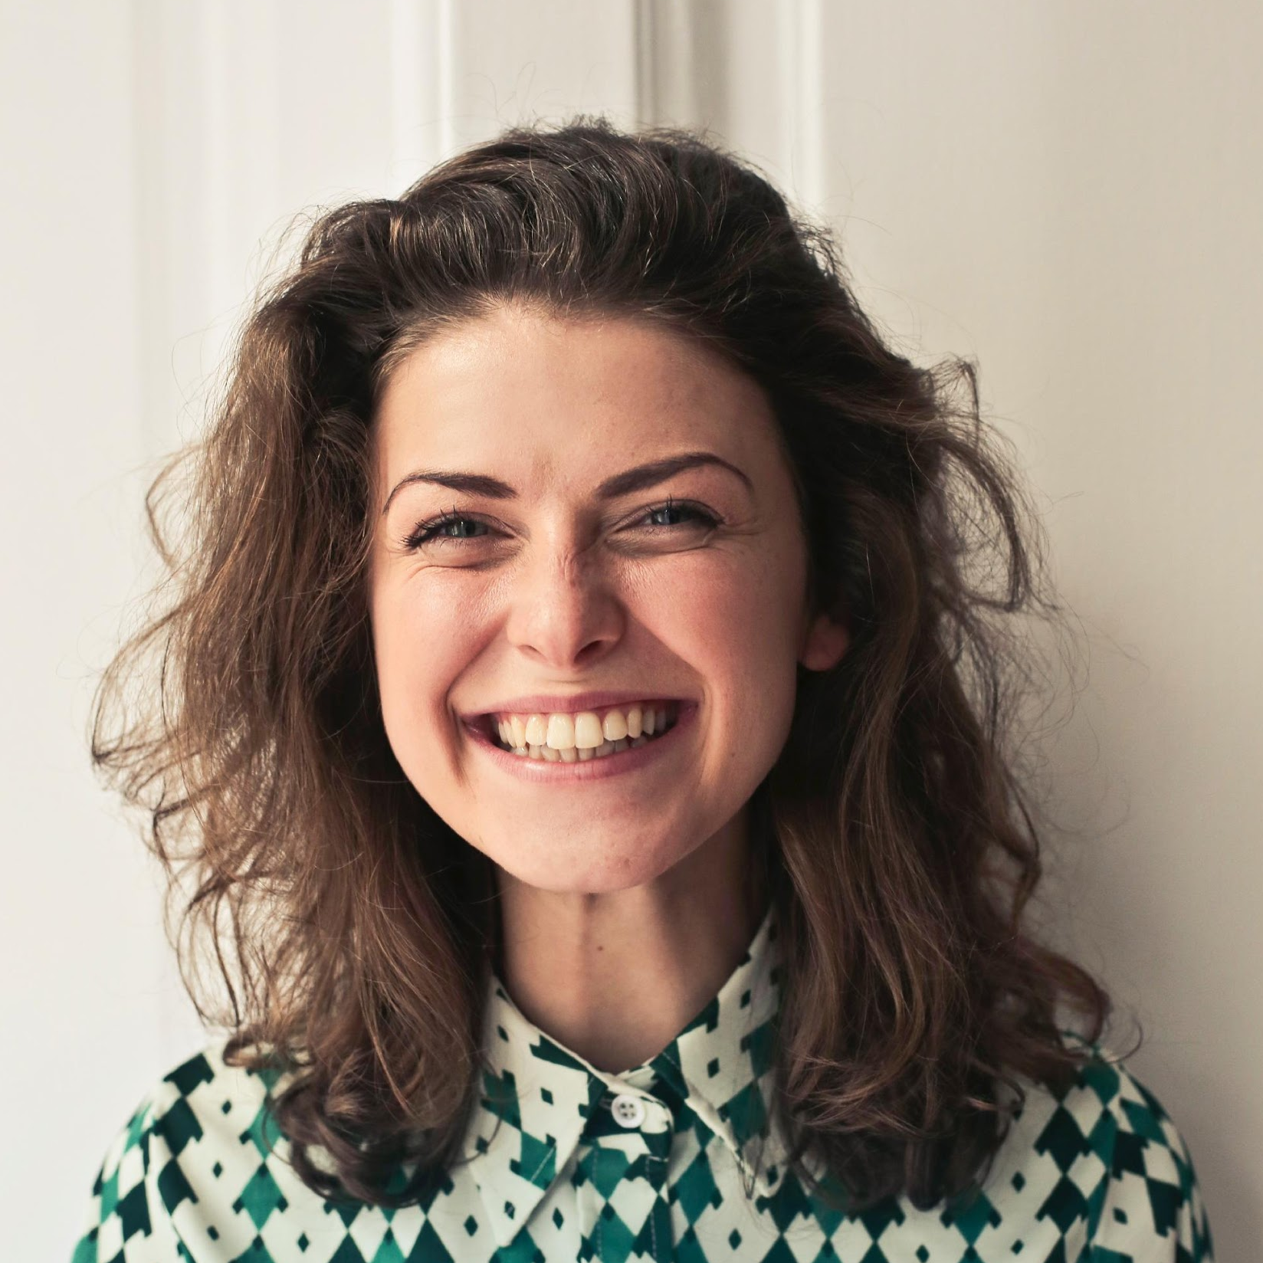

Testimonials
Sophia Holiday, 31, Volunteer
Baron Family, Volunteer
Thank you so much for the laptop computer you provided for Zeke. It has been very helpful for him and I'm sure will continue to be helpful for a long time.
Thank you so much for making my family your priority. It has meant the world to my mom to have a decent car. You, Cameron + the rest of the team have really changed her life and given her a new chance.

Slide 23
THANK YOU!
CHILD CARE FOUNDATION
(000) 111 2222 | dm@childcarefoundation

