Slide 1
HOPE INVESTMENT INC.
Investor Pitchdeck Presentation
invest@hope.com

Slide 2
Our Agenda for Today
02
18 GOING 50
01
This will be held at the Downtown Avenue on July 13, 2022 from 12pm to 5pm. Tickets start at $50 per person and will include free agent consultation, an investment kit and free snacks. 95% of the profits gained will be donated to the Hope Life Foundation.
INVEST NOW, WORRY LATER
02
This will be held at the Downtown Convention on April 12, 2023 from 8am to 6pm. Tickets will be at $99 each with a free agent consultation, a 30% discount on product packages and free snacks. 80% of profits will be donated to Save Earth Foundation and the remaining 20% will be used to upgrade the company’s system, offices and equipment.
TRI MONTH BOARD MEETING
03
Members of the Board will be having their tri month meeting at the Downtown Meeting Center on June 10, 2020 from 12 pm to 5 pm to discuss the Hope Investment, Inc.’s future plans from 2022 to 2025. This meeting will plot the general plan for the company’s performance, status, profit, extension branches and system upgrades.

Slide 3
03
About the Company
Hope Investment, Inc. is an investment & investor company located in Manhattan, New York. It was founded in 1990 by Howard Levine who was a former stockbroker, an Economics professor and philanthropist.

Slide 4
“This year poses new challenges that we as a company must take on to create products that are efficient and affordable.”
-Howard Levine, Founder & CEO

Slide 5
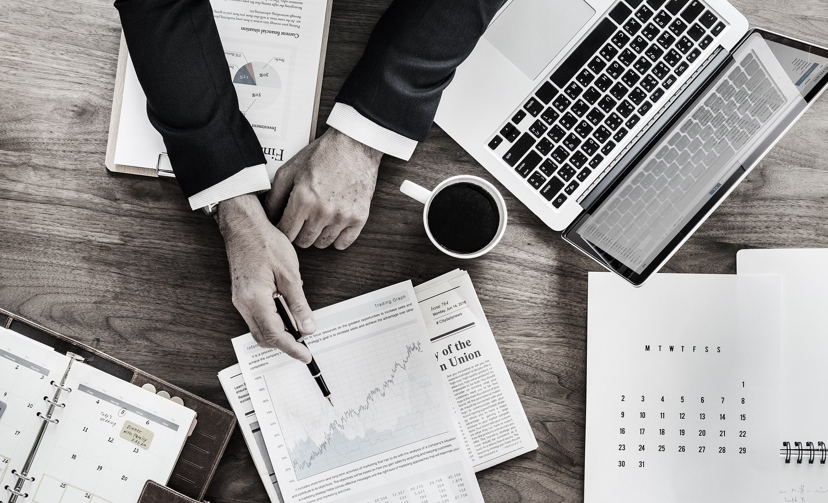
18
Going
50
05
July 13, 2022 | 12 PM - 6 PM
Downtown Avenue
Tickets start at $50 per person and will include free agent consultation, an investment kit and free snacks. 95% of the profits gained will be donated to the Hope Life Foundation.

Slide 6
06
Invest Now, Worry Later
April 12, 2023 | 8am to 6pm
Downtown Convention
Tickets will be at $99 each with a free agent consultation, a 30% discount on product packages and free snacks. 80% of profits will be donated to Save Earth Foundation and the remaining 20% will be used to upgrade the company’s system, offices and equipment.

Slide 7
Tri
Month Board Meeting
07
June 10, 2023 | 12pm to 5pm
Downtown Meeting Center
This meeting’s agenda is to plot the general plan for the company’s performance, status, profit, extension branches and system upgrades.

Slide 8
08
History of
Company
Hope Investment, Inc. was founded in the year 1990 by Howard Levine who was a former stockbroker, an economics professor and philanthropist. The company’s aim is to inspire every individual to become confident investors through effective, reliable investment products and packages. It has been operating for over 28 years and counting and currently has 5 fully operating branches in New Mexico, Miami, New York, Los Angeles and Alaska with 10,000 staff members and nearly 1.5 million active members.

Slide 9
Testimonial
“I am very grateful for Hope Investment, Inc. They do their best to help me excel and succeed in financial and investment industry through legal and effective investment advice.”
-Newman Brown, 33, Financial Investor

Slide 10
10
Main Goal
Hope Investment, Inc.’s main goal is to become the leading investment & investor company in the country by giving and generating effective financial products and strategies.

Slide 11
11
Overview of Growth
Increase in annual profits as of May 2021.
35%
80%
Increase in satisfaction with developed website templates as of March 2021.
Increase in clientele base as of March 2021.
60%

Slide 12
What We Offer
12
Financial Strategic Plans
Free Financial Adviser Consultation
Affordable Investment Packages
Fast, Reliable and Hassle-Free Services

Slide 13
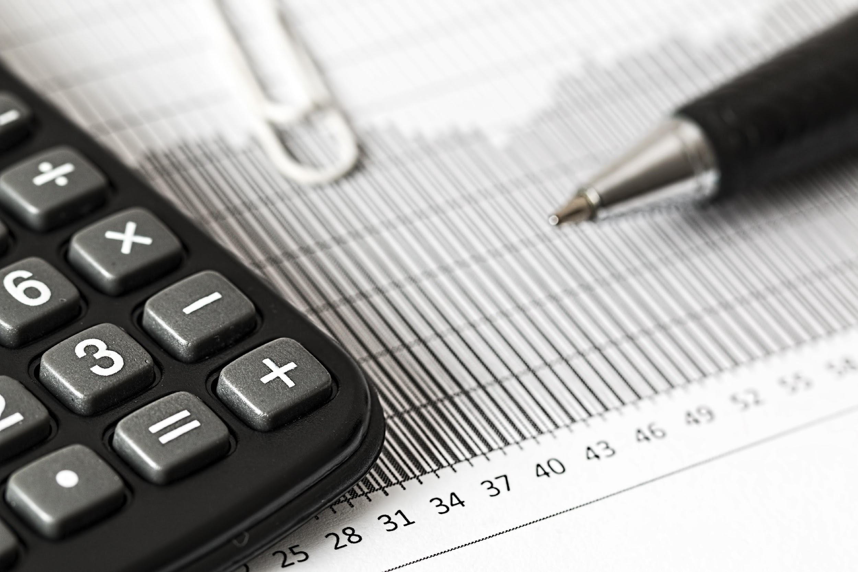

Slide 14
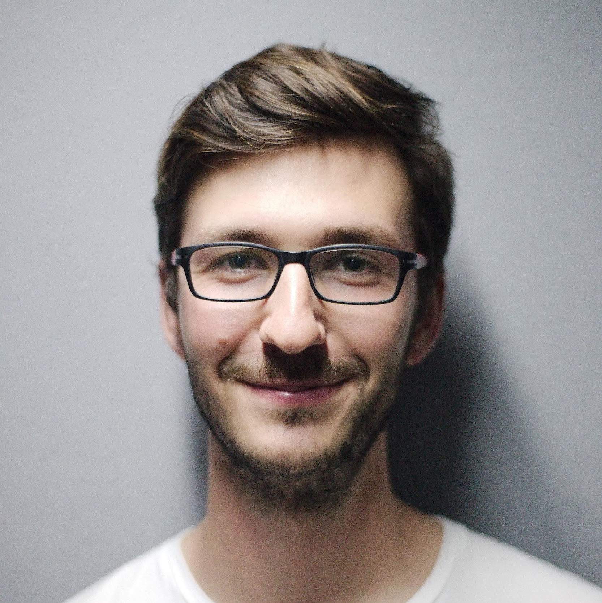
Management
14
Mason Anderson
Bella Williams
Jerry Black
Chief Executive Officer
Chief Marketing Officer
Tech Consultant

Slide 15
THANK YOU!
HOPE INVESTMENT INC.
(000) 111 2222 | invest@hope.com

