Slide 1
Marie’s
Wedding Studio
Event Plan
For Year 2040
March 10, 2030
Peter Arbor | p_Arb0r@gmail.com
830-968-4207
www.arborpeter.com
470 Strother StreetKennedy, AL 35574, USA

Slide 2
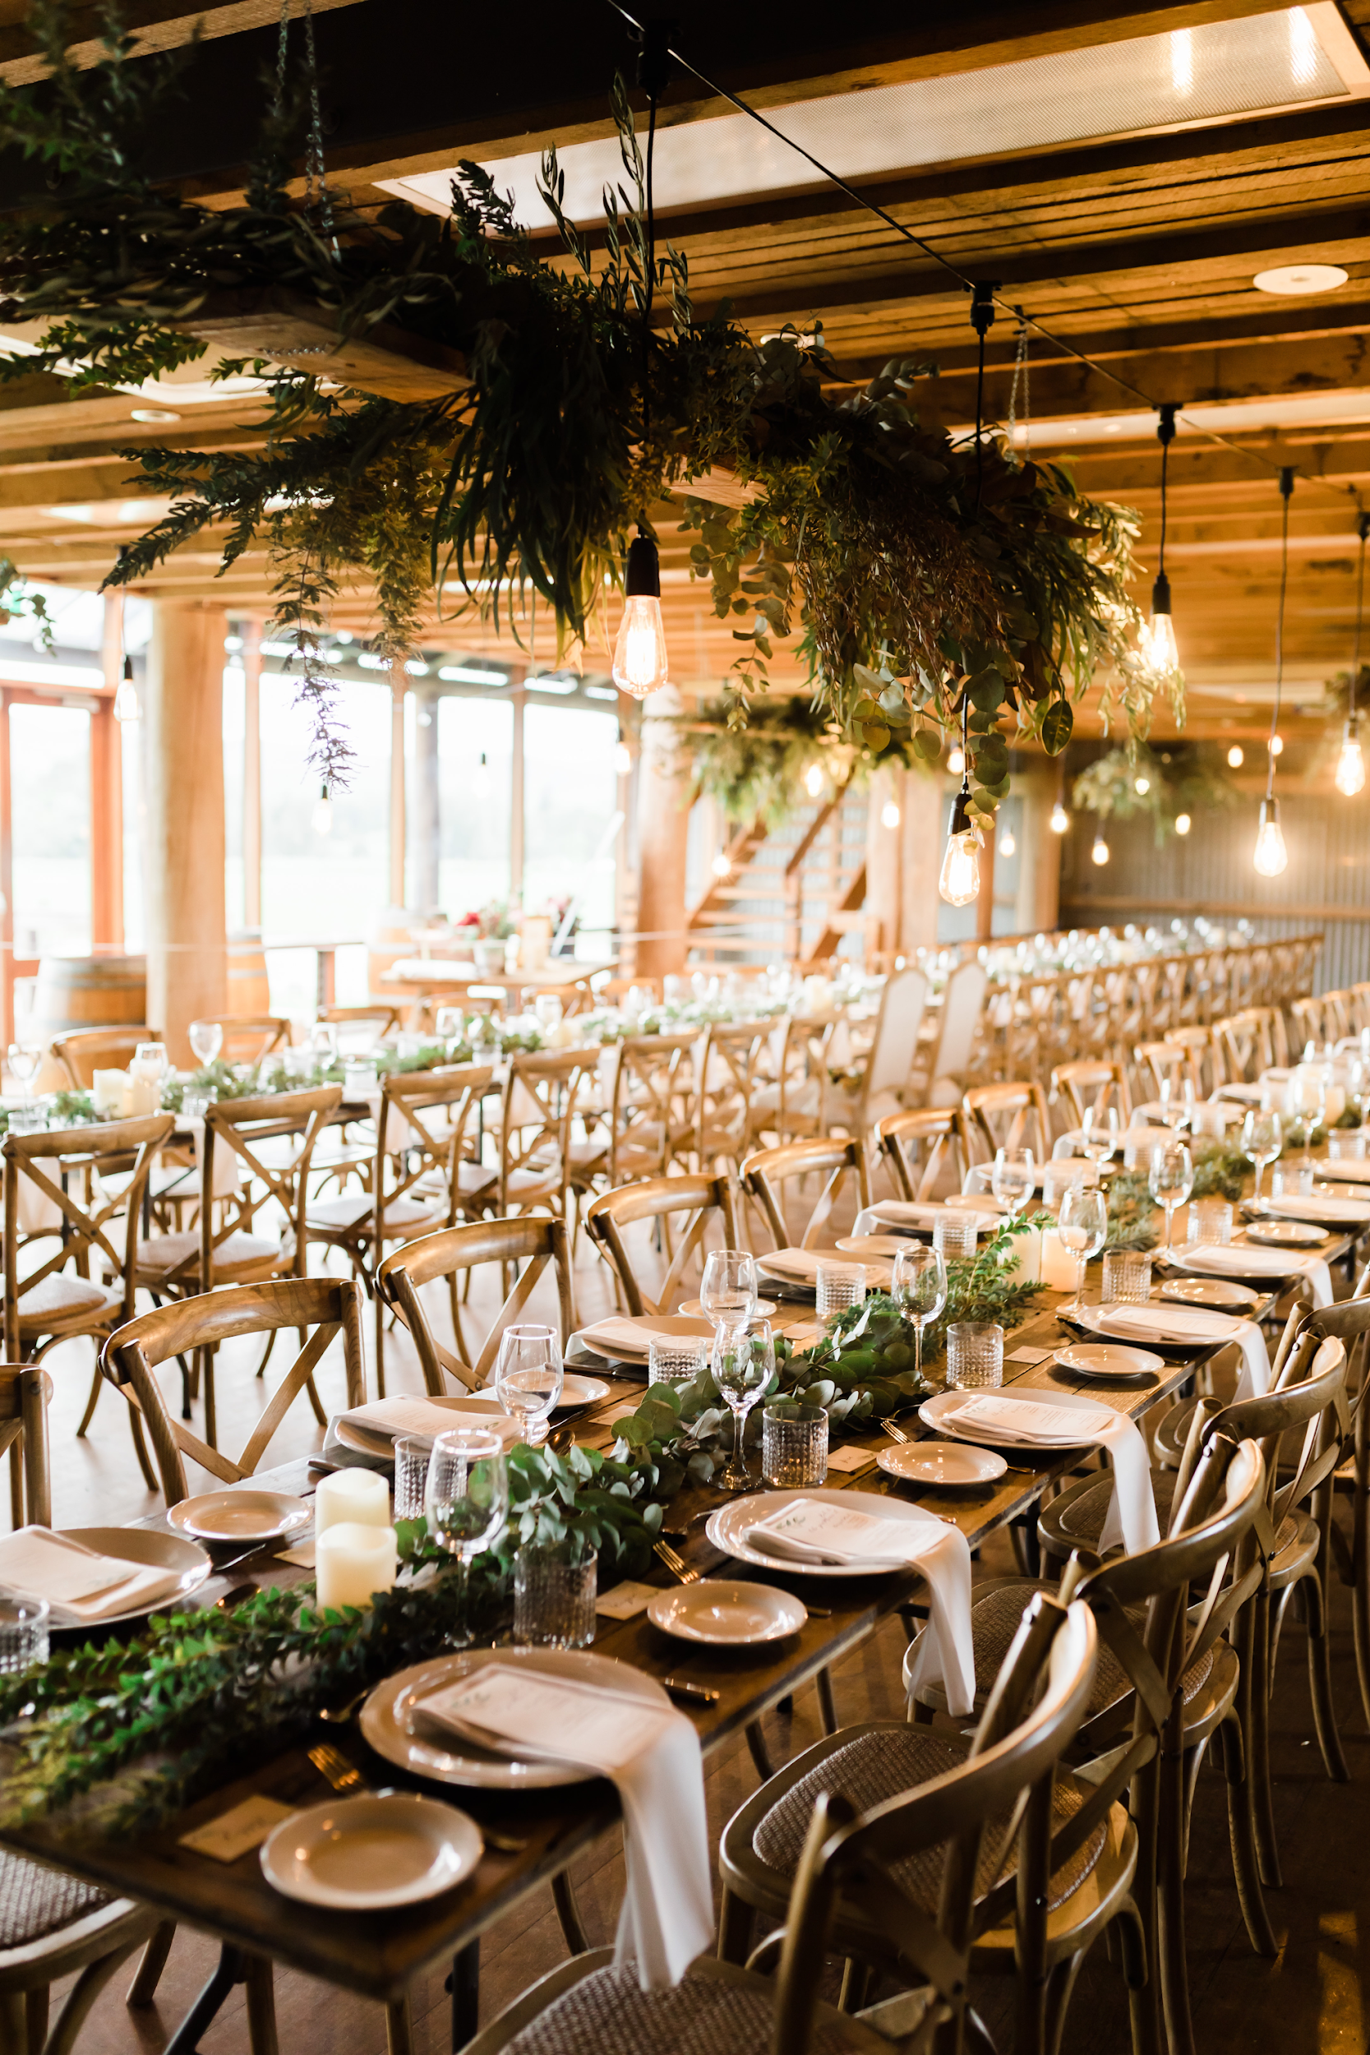
Marie’s
Wedding Studio
event plan
for year 2040
The Company
Main Goal
Once in a Blue Moon
Moonlight Lady
Bi Monthly Board Meeting
Overview of Growth
What we Offer

Slide 3
Marie’s
Wedding Studio
the
company
Know more about the history of the company that brought life to the wedding dreams of every couple.

Slide 4
Marie’s
Wedding Studio
executive summary
Marie’s Wedding Studio is an American wedding studio company located in the lively city of Miami, Florida. With 5 branches established and counting, Marie’s Wedding Studio aims to give all its clients quality wedding services at affordable price points.
Founded in 1993 by Julia Marie, a former wedding gown designer, professor and model.

Slide 5
Marie’s
Wedding Studio
executive summary
Marie’s Wedding Studio helps clients with their wedding dream needs. The company’s skilled team of professional production managers and event organizer will provide clients with innovative and efficient solutions to make their wedding dreams into reality.

Slide 6
Marie’s
Wedding Studio
mission
Marie’s Wedding Studio aims to provide credible wedding for the couples.
vision
Marie’s Wedding Studio aspires to stay dynamic and relevant in the modern age and establish itself as a formidable wedding studio in the industry.
philosophy
Marie’s Wedding Studio believes in applying creativity, simplicity, honesty, and efficiency to their work in order to achieve its goals of providing the best service to clients.

Slide 7
Marie’s
Wedding Studio
outlook
The Wedding Studio industry is currently thriving and is foreseen to continue growing. This is due to the couples who want their wedding to be memorable.

Slide 8
main
goal
the goal that made the company succeed in the number one spot.

Slide 9
Marie’s
Wedding Studio
goal
Marie’s Wedding Studio’s main goal is to become the leading wedding planner and organizer by offering and producing the best quality of wedding packages for all.

Slide 10
Marie’s
Wedding Studio
pricing strategy
The company uses a combination of cost-plus and price bundling when offering its services. This combination best suits the company and is common in the industry.
Formula:
Profit Margin = 1- (Expenses/Net Sales)
Marie’s
Profit Margin = 1 - ($114,000/$350,000)
= 1-0.33
= 0.67 or 67%

Slide 11
blue moon
once in a

Slide 12
Marie’s
Wedding Studio
Once in a Blue Moon
Grand Town Cape
July 4, 2023 | 12pm to 6pm
Tickets start at $20 and will include up to 30% discounts on all wedding packages and a free wedding planner consultation. Gained profits from this event will be donated mostly to the renovation of the Cape Foundation, Inc.’s facilities and system.

Slide 13
lady
moonlight

Slide 14
Marie’s
Wedding Studio
MOONLIGHT LADY
Grand Town Convention Center
July 4, 2023 | 9am to 6pm
Tickets start at $50 and will include a free wedding planner consultation. 80% of profits from this grand convention will be donated to the Amazon forest reforestation and the remaining 20% will be used for the soft opening of Marie’s Wedding Studio New York branch.

Slide 15
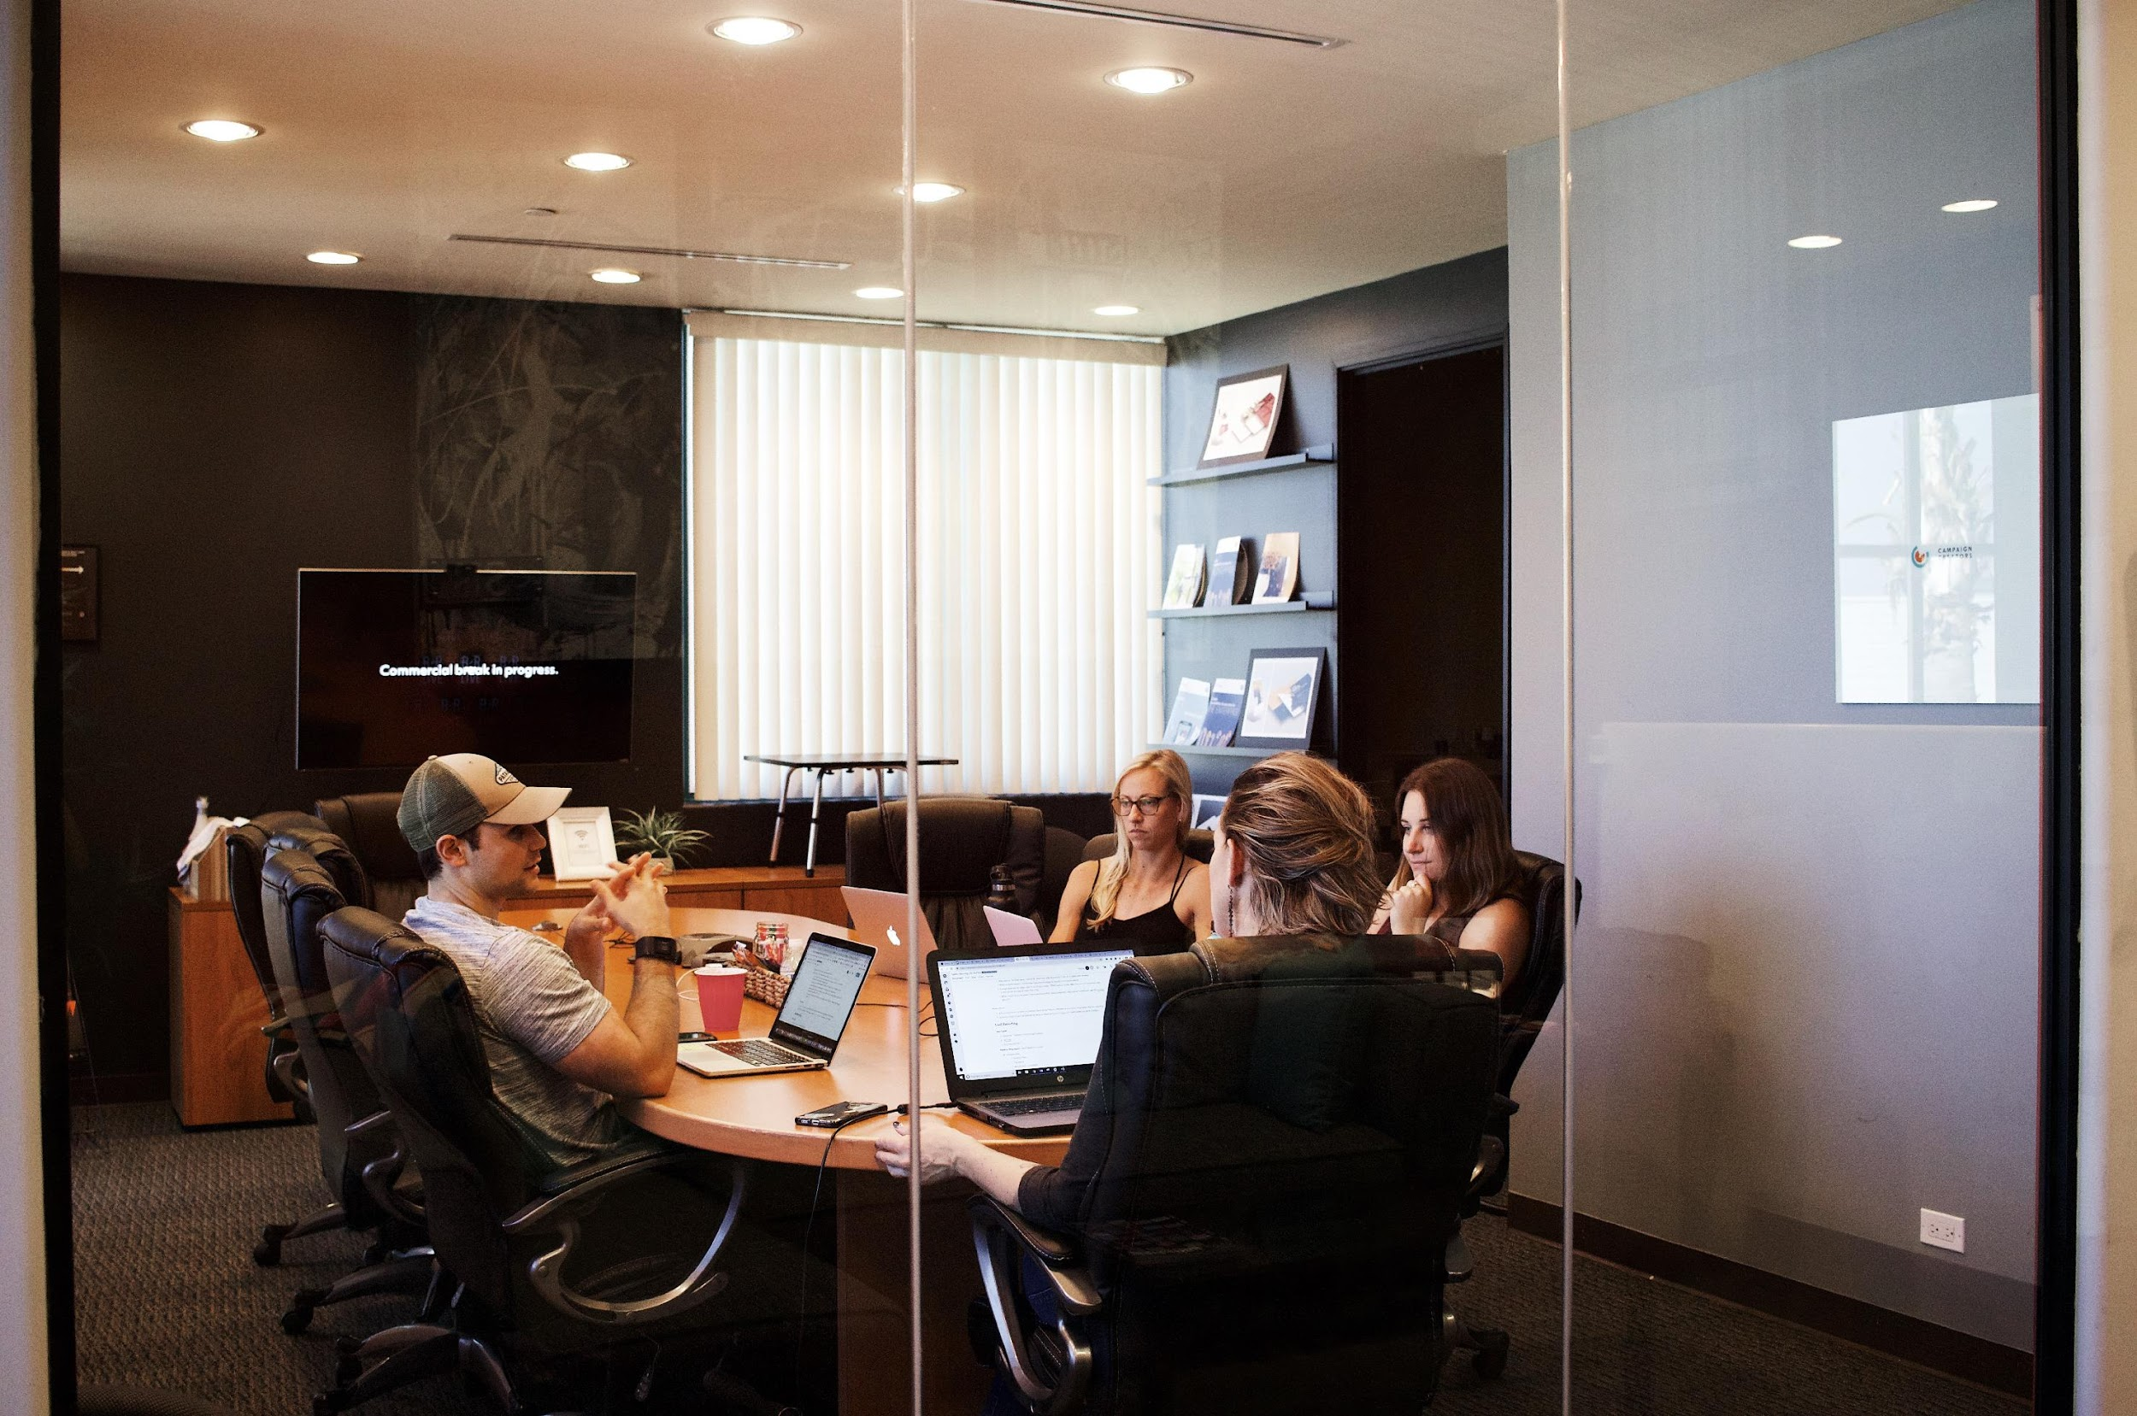
Marie’s
Wedding Studio
bi-monthly
board meeting

Slide 16
Marie’s
Wedding Studio
BI MONTHLY BOARD MEETING
Green Square Restaurant
July 20, 2020
12pm to 6pm
This board meeting will also include the review, analysis and implementation of new general guidelines to maintain the success, profit, performance and marketing strategies of Marie’s Wedding Studio from 2022 to 2025.

Slide 17
Marie’s
Wedding Studio
testimony

Slide 18
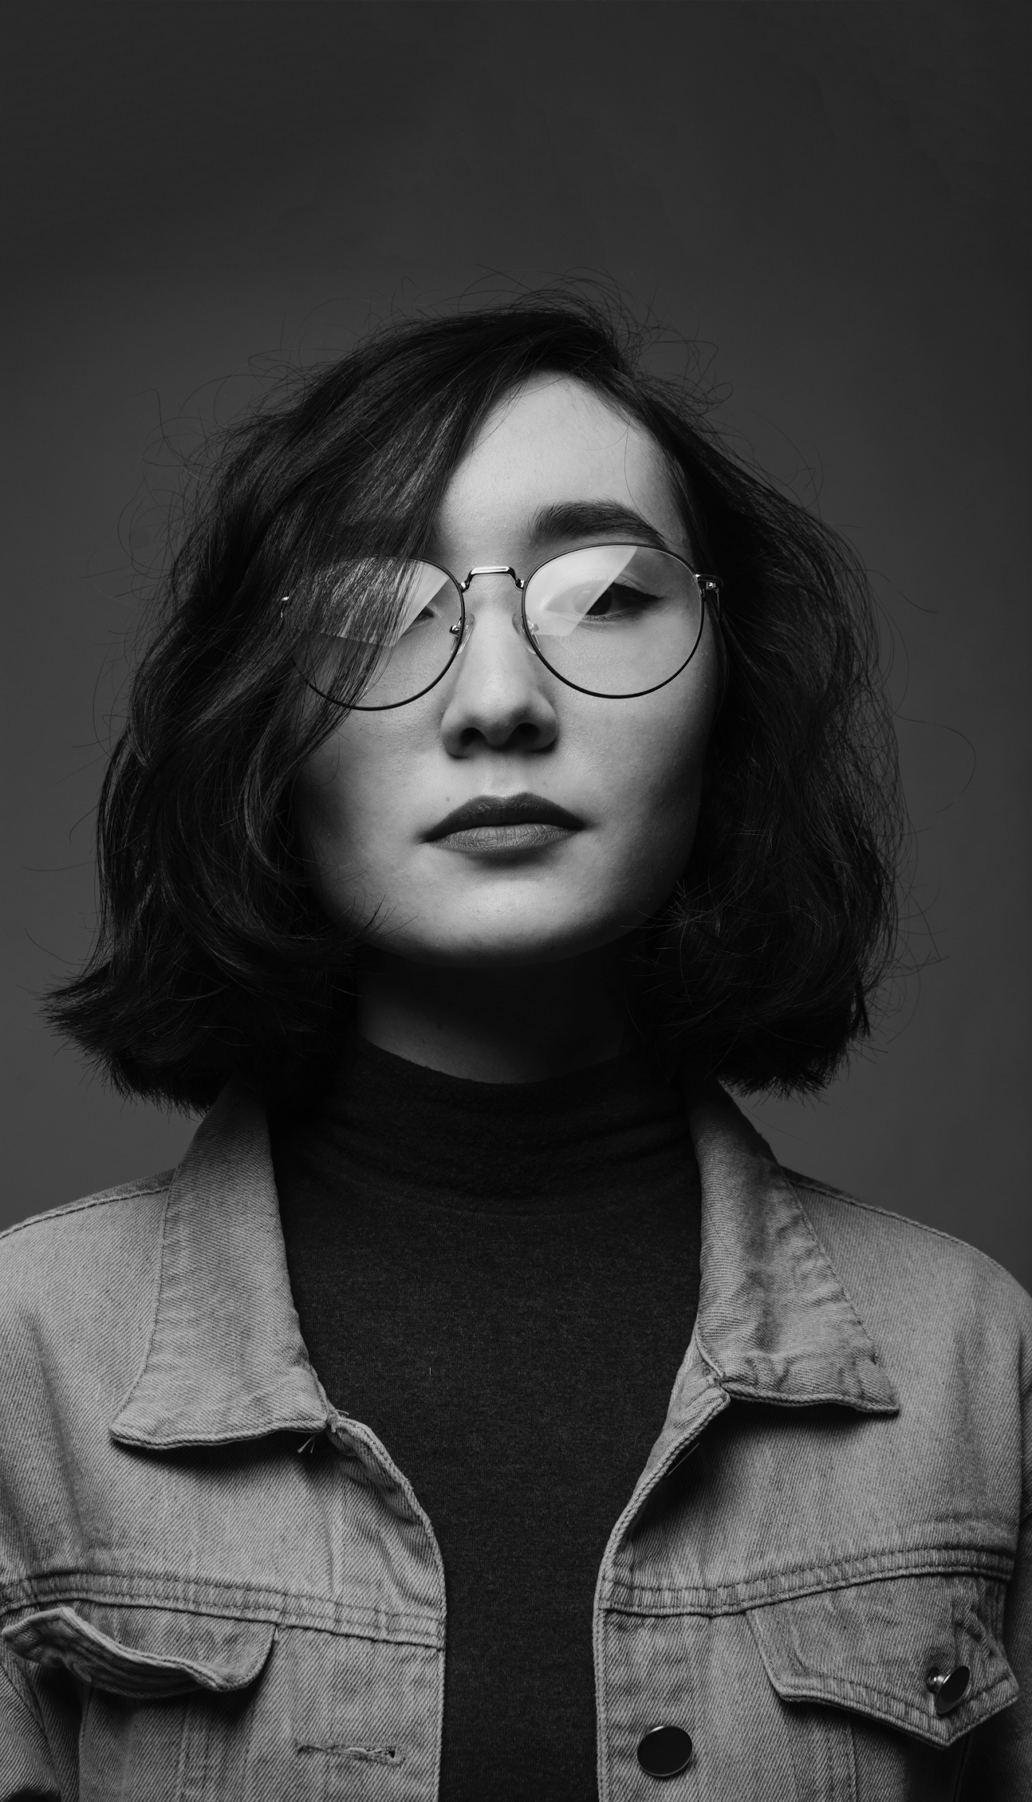
Marie’s
Wedding Studio
“
If you are looking for an affordable, accommodating, hassle free wedding experience, inquire and avail now at Marie’s Wedding Studio.
-Kate Black
”

Slide 19
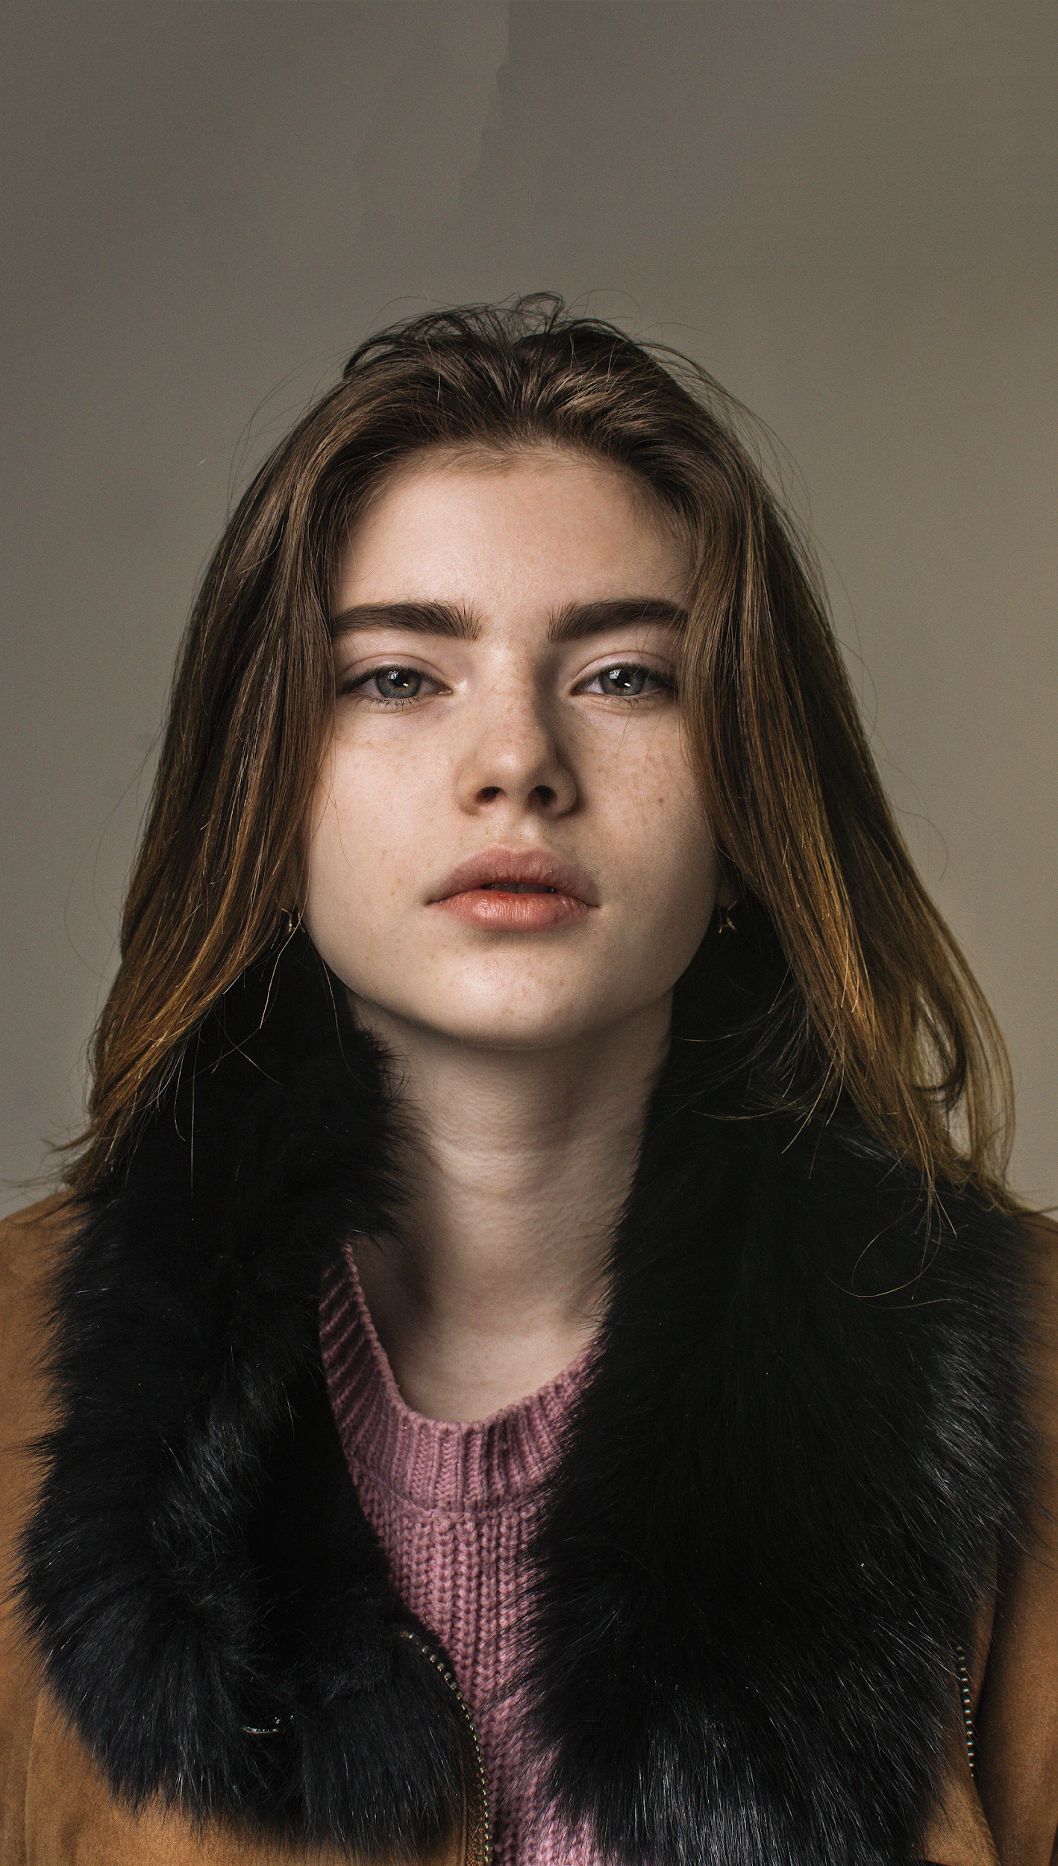
Marie’s
Wedding Studio
“
Marie’s Wedding Studio prioritizes all guests and visitors while providing the best possible experience with their well planned and organized wedding packages.
-Jenny Shaw
”

Slide 20
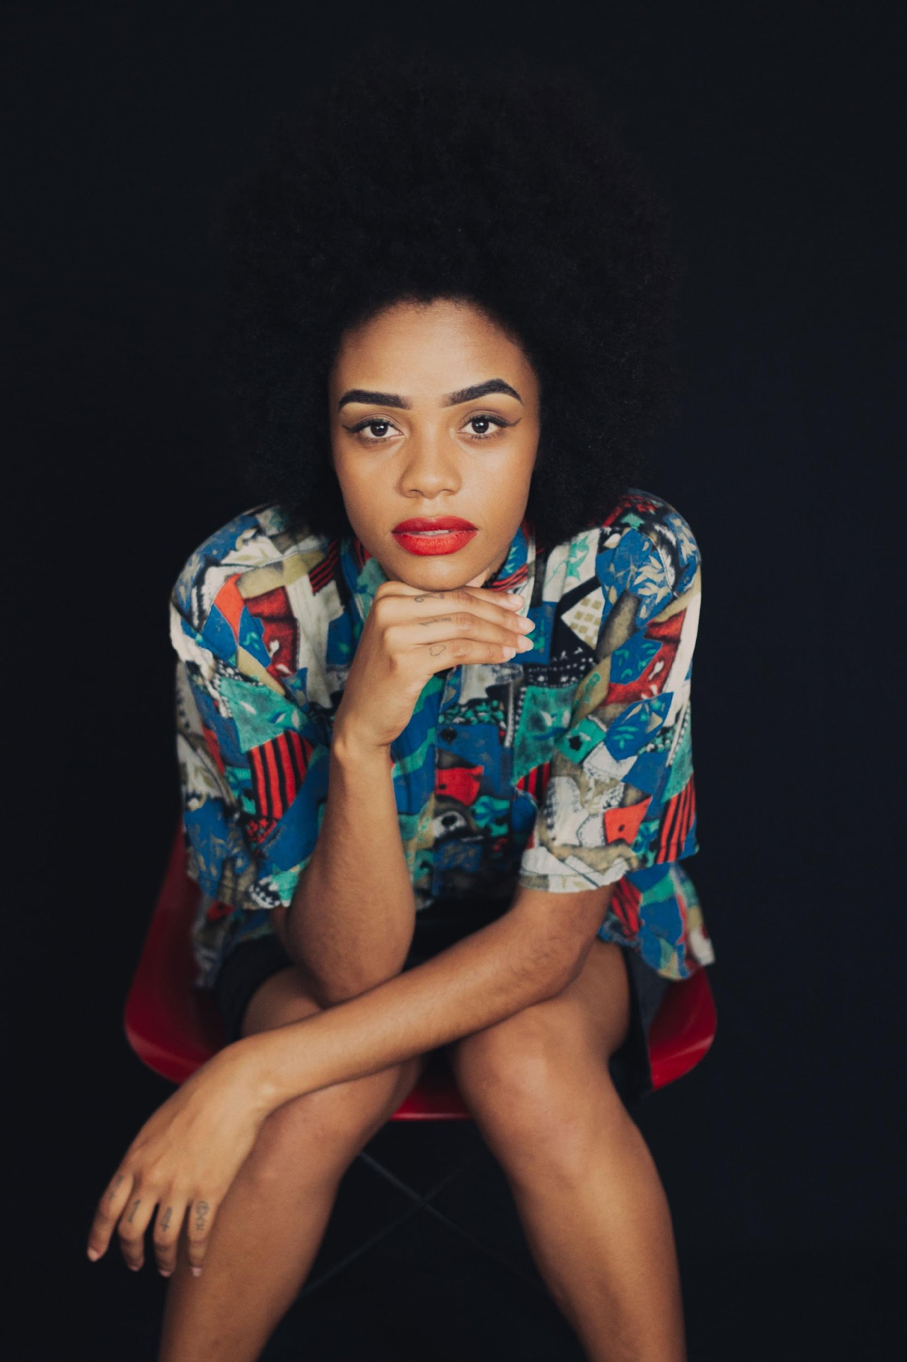
Marie’s
Wedding Studio
“
“Marie’s Wedding Studio is a welcoming company that gives you a memorable wedding experience for an affordable and convenient price point.
-Julia Marie
”

Slide 21
Marie’s
Wedding Studio
overview
of growth
25%
increase in new clients
satisfaction as of March 2021.
80%
increase in sponsor
satisfaction as of March 2021.
70%
increase in annual profits
satisfaction as of March 2021.

Slide 22
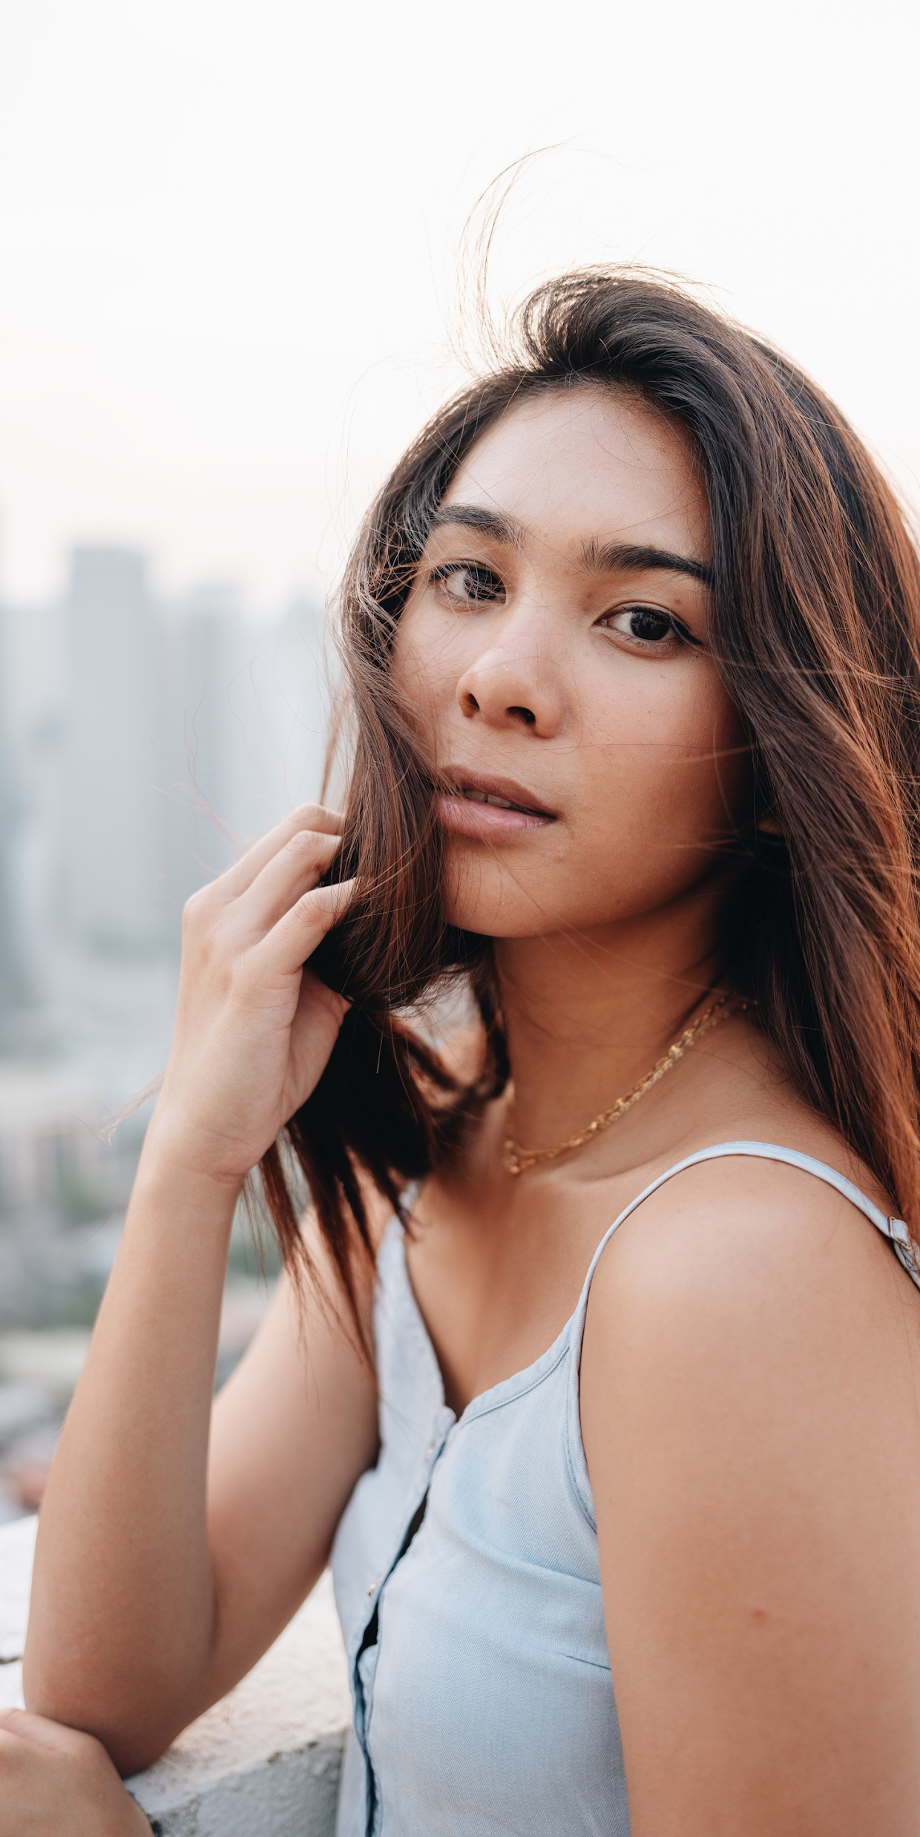
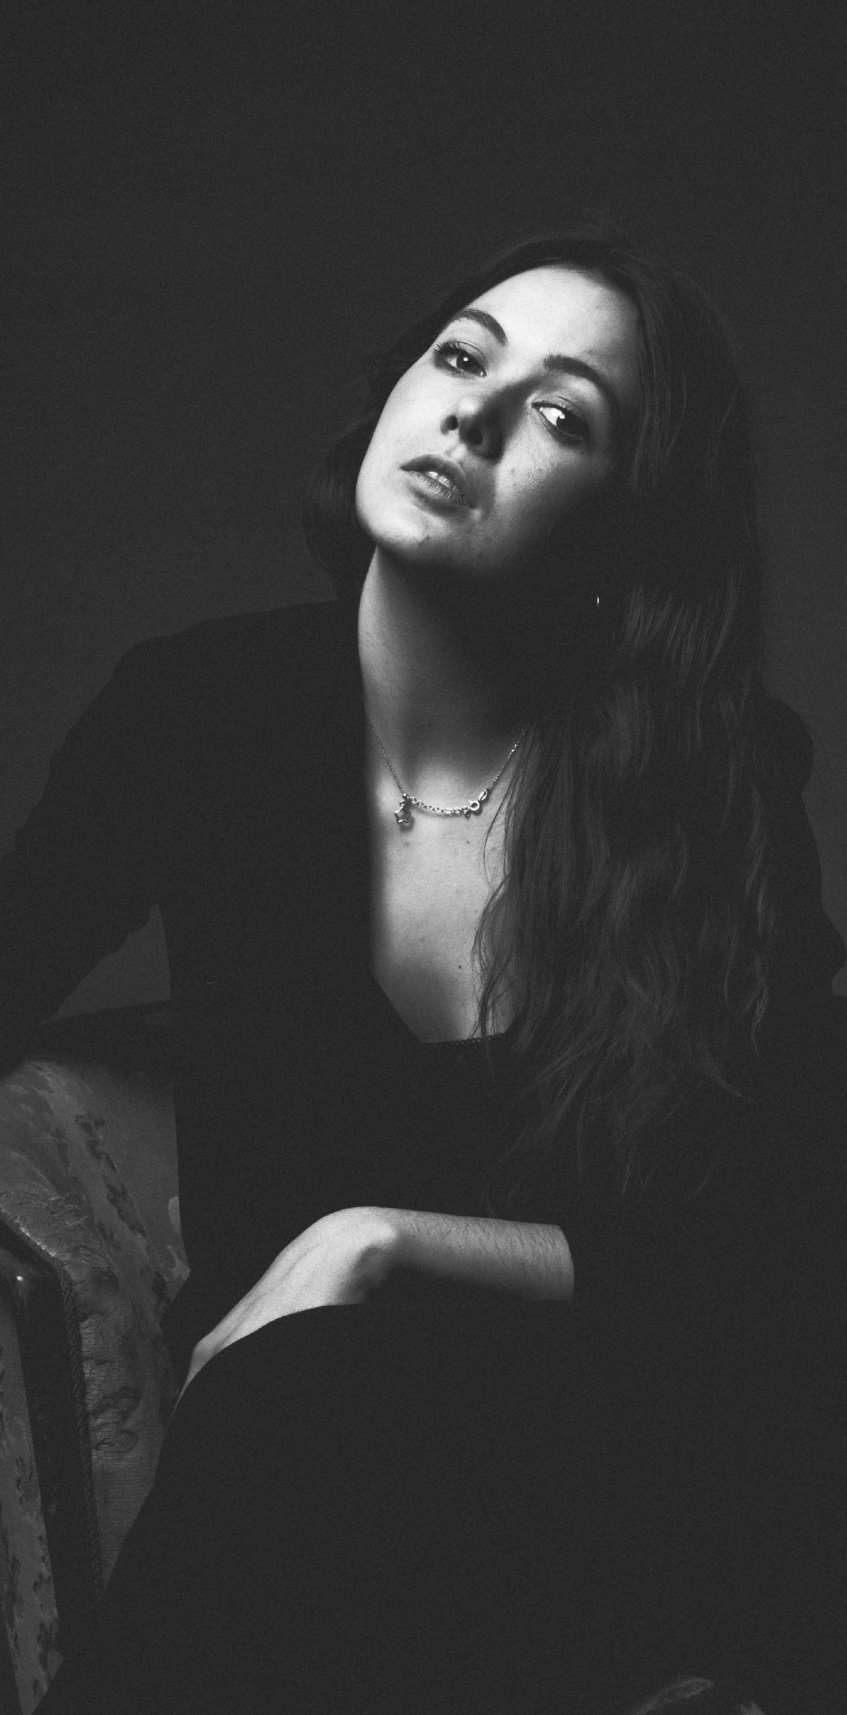
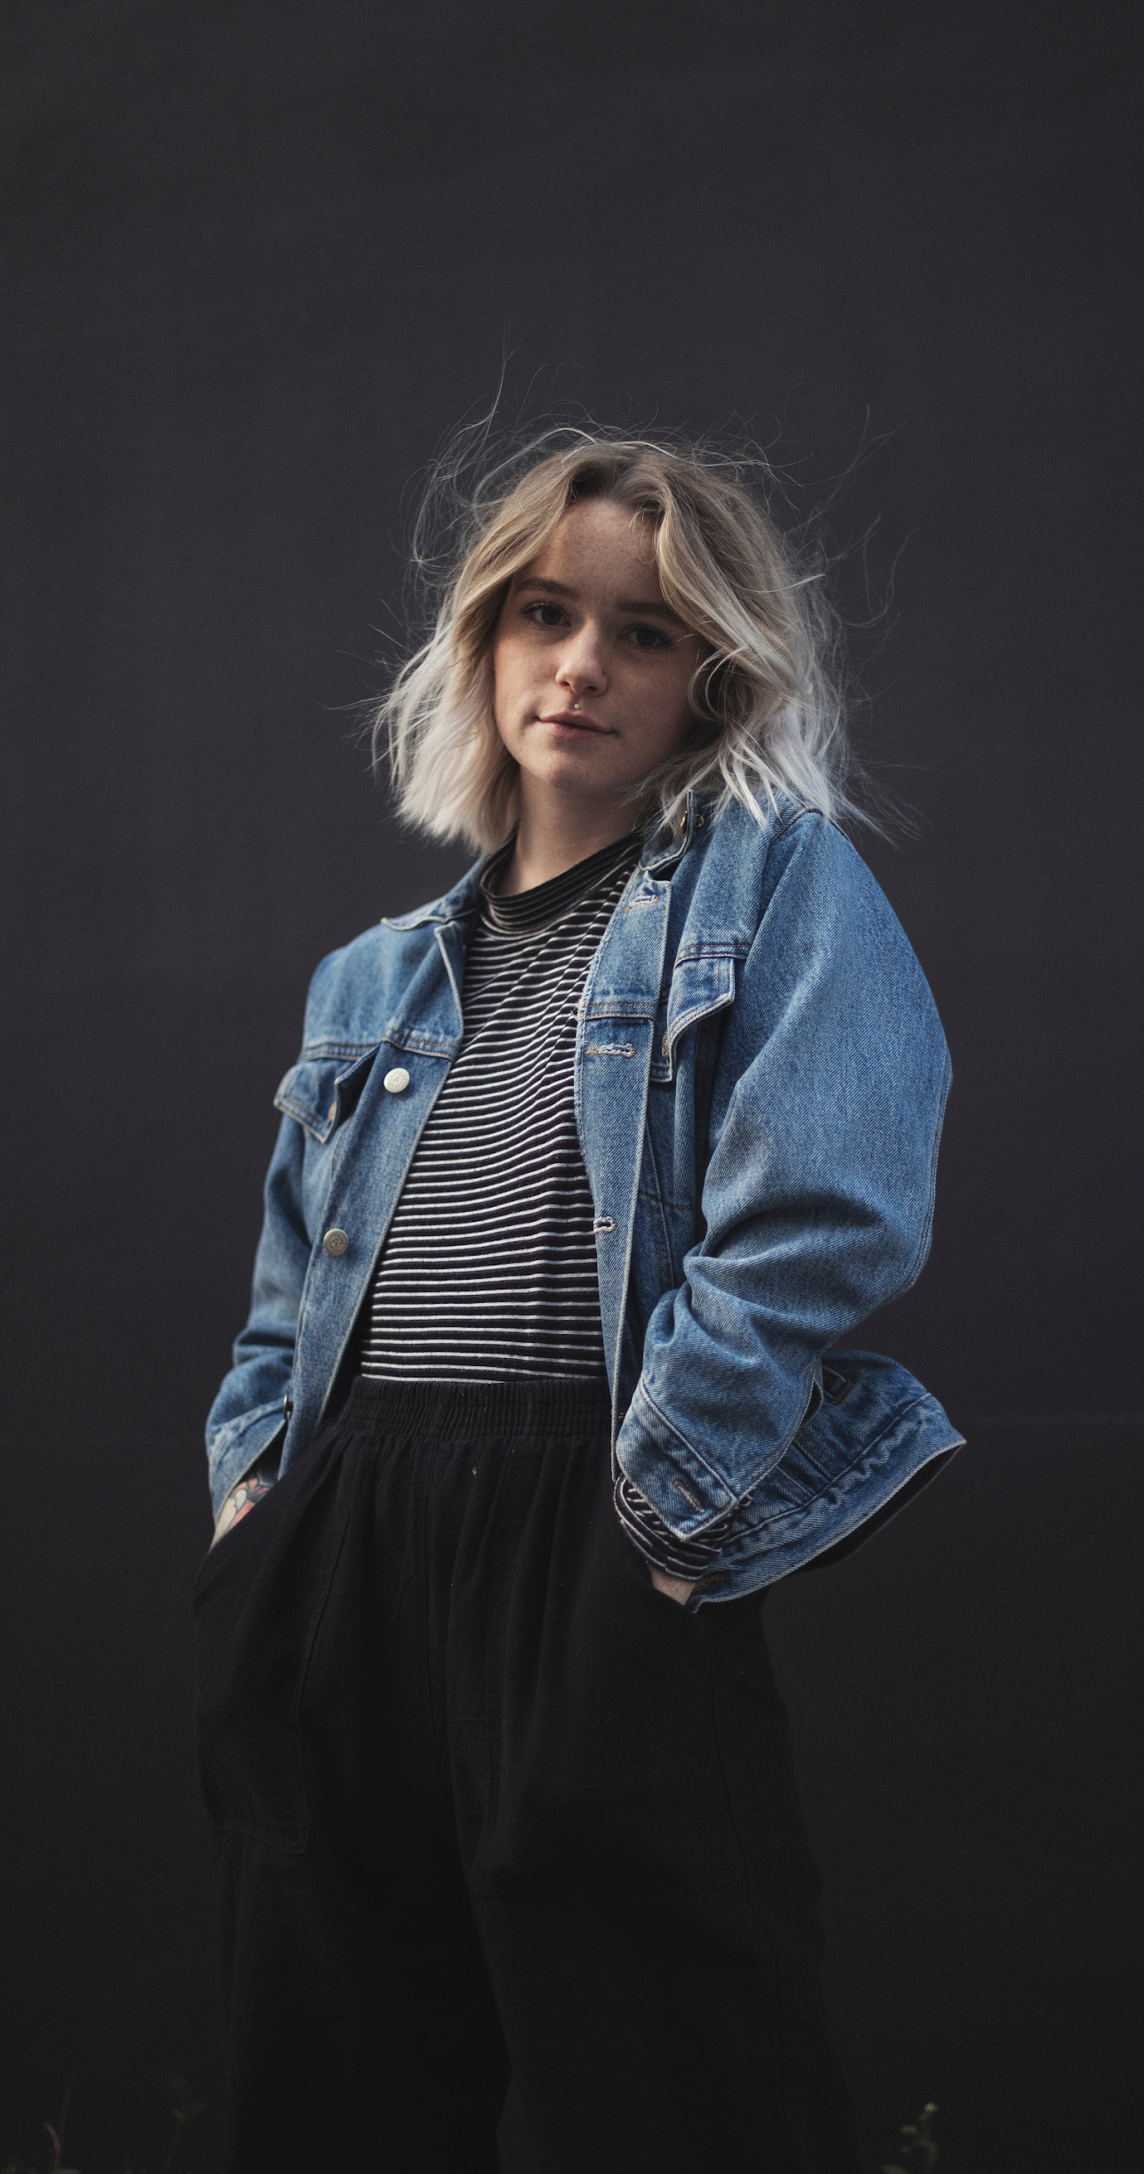
Marie’s
Wedding Studio
Julia Marie
Alexander Gay
Chairman & CEO
Chief Operating Officer
the
Jenny Shaw
Chief Marketing Officer
management

Slide 23
Marie’s
Wedding Studio
what we offer

Slide 24
Marie’s
Wedding Studio
01
Couple
Wedding Seminar
Wedding Reception
Organizer
Effective & Reliable
Wedding Packages
Wedding Planner

Slide 25
Marie’s
Wedding Studio
Thank You
marie's@weddingstudio.com
+736 83729

